Slide 1

Vellure – trusted care, nearby.
Created by:
Anastasiia Vivtonenko
Juraj Janíček
Le Duc Hung
Rostislav Lyapkin
Marek Sádovský

Slide 2

Vellure – the self-care marketplace
Application/website that can offer self-care services from local businesses for people, all in one place. Users can get the closest, cheapest, most relevant or the fastest service without browsing hundreds of websites in google maps. Users don’t have to call anyone to order any services (for introverts). Small businesses without great visibility on Google/Apple Maps receive more clients for a part of their earnings, without need to spend a lot of money on marketing and advertisement. Service provider can select free slots for any kind of services in Calendar. Users can expect to get the quality of service they paid for; we provide only certified specialists. Ai powered.

Slide 3
Some of our user stories
Manage Certifications As a business, I want to upload and update my certifications or licenses, so that clients can trust the quality of my services.
Client rating system
As a business, I want to be able to rate my clients so I can decide whether to work with them again.
Finding the closest service As a client, want to be able to find services based on a map, so I can find the closest last-minute service when I need and I don't have to iterate through the list of businesses.
Compare reviews
As a client I want to see how was each business reviewed so it helps me to choose better business even when are two business really similar
Reviewing Services
As a client, I want to review the services I’ve received so I can help others make informed decisions and give feedback to the business providing the service.
Access Service History
As a client, I want to access my past appointments and service details, so I can easily re-book or refer to them when needed.
Refund request option As a client, I want to be able to request a refund so that i can get money back if:
I paid for a reservation but canceled it at least 24 hours in advance.
I paid for a service but I am not satisfied with the result.
The business cancels my reservation.
Filtering services
As a client I want to be able to filter services by price range, category, distance, time availability, so that I won't be overwhelmed by the number of the services that I see.
Book service online
As a client, I want to book services entirely online without needing to call, so that I can comfortably and efficiently schedule appointments.
Service customization
As a business, I want to list variety of services with customizable pricing and durations, so that I can cater to a variety of client needs.

Slide 4
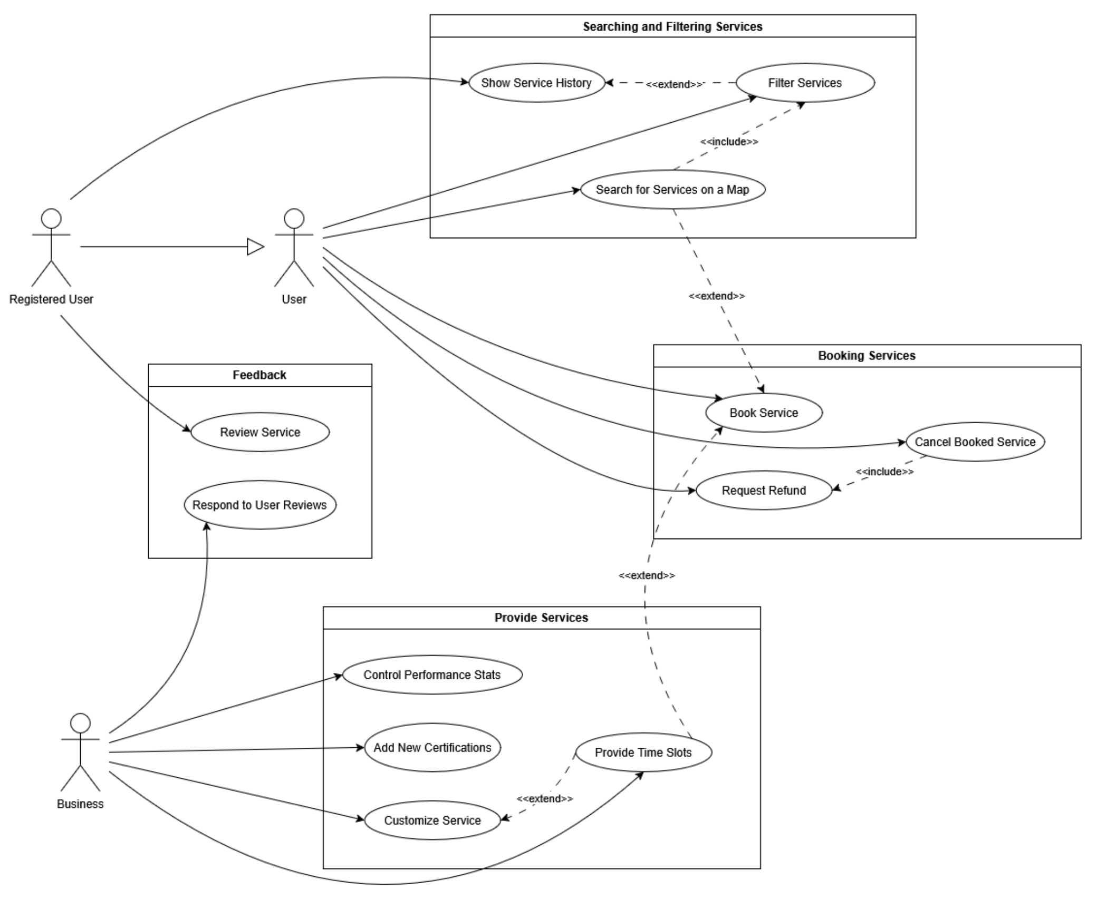
Use case diagram

Slide 5

Use case details
Actors:
Client
Preconditions:
The client has found and selected a service
they want to book.
The client has clicked the button to book this service.

Slide 6
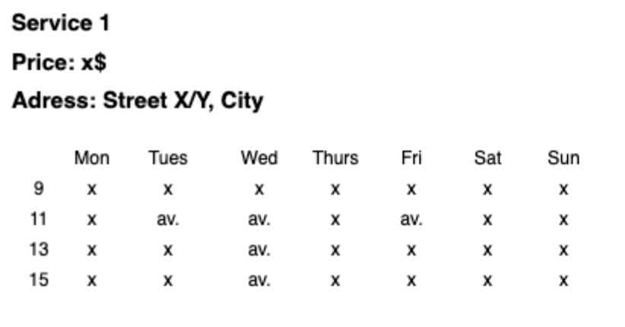
Use case details
Basic Flow:
The system displays the details of the selected service.
The system shows a calendar with available time slots for booking.
The client selects one of the available time slots in the calendar.

Slide 7
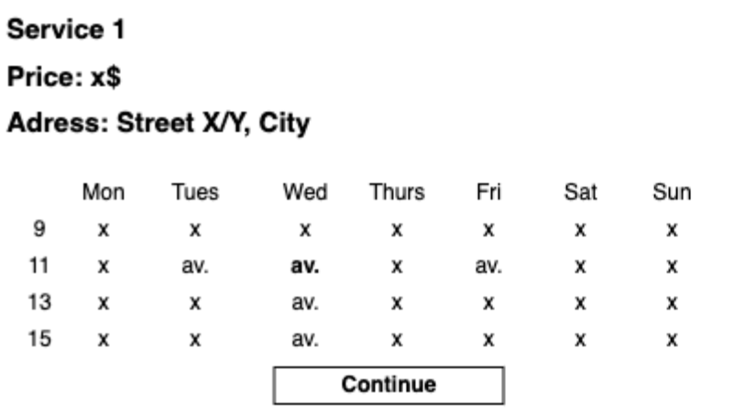
Use case details
Basic Flow:
4. The system verifies the selected time slot is still available and displays a "Continue" button.
5. The client clicks the "Continue" button.

Slide 8
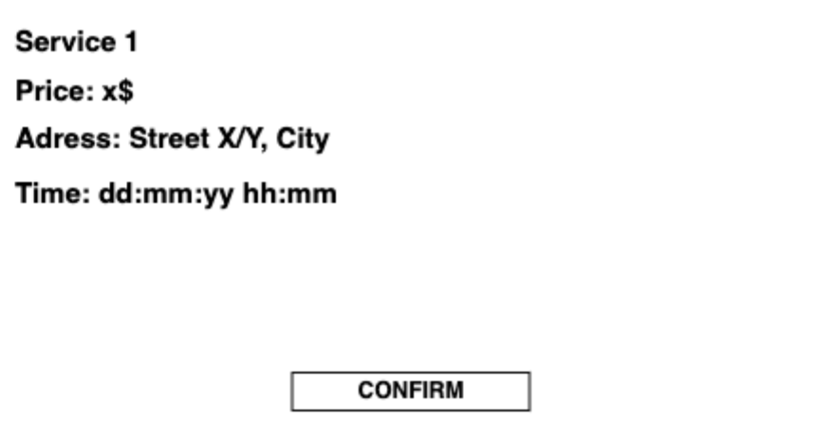
Use case details
Basic Flow:
6. The system displays the order summary.
7. The client reviews and confirms the order details.

Slide 9
Use case details
Basic Flow:
6. The system displays the order summary.
7. The client reviews and confirms the order details.

Slide 10
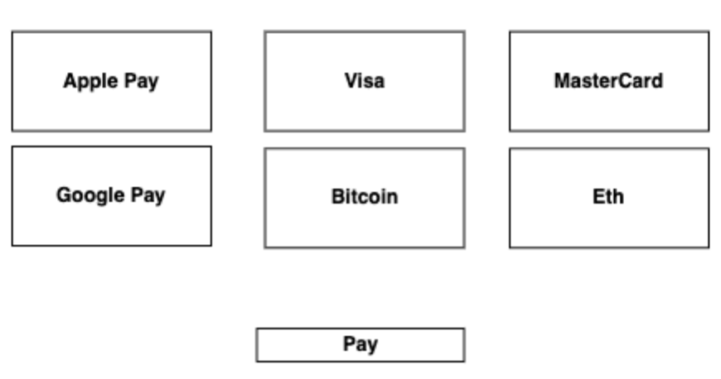
Use case details
Basic Flow:
8. The system creates the booking.
9. The system displays a page with available payment methods.
10. The client provides payment information and completes the payment for the service.

Slide 11
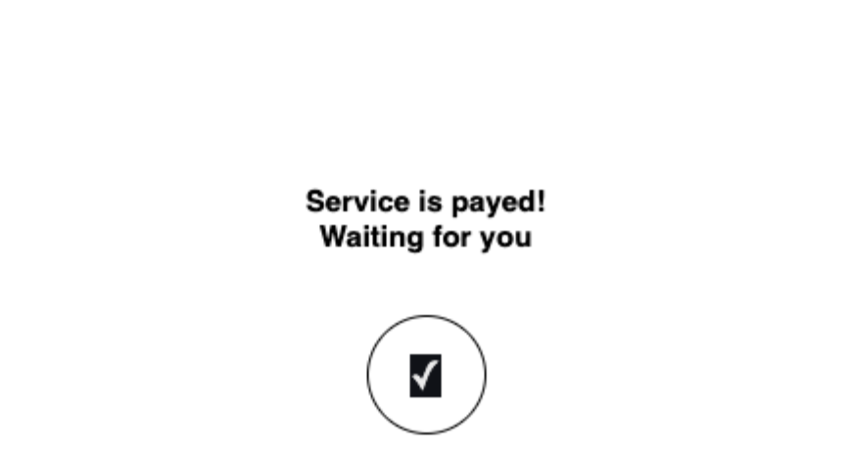
Use case details
Basic Flow:
11. The booking is marked as paid and confirmed.

Slide 12
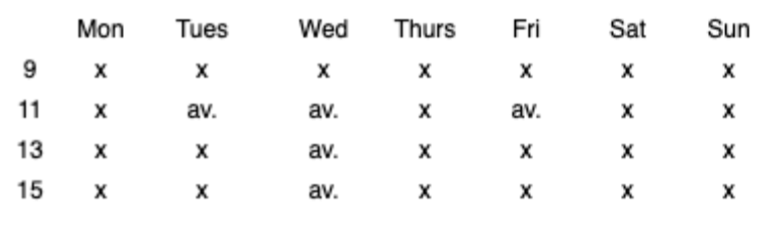

Use case details
Alternative Flow:
2a. No Available Time Slots
2a.1 The system notifies the client that there are no available time slots for the selected service.
2a.2 The client clicks the "Acknowledge" button.
2a.3 The system stops the booking process.

Slide 13
Alternative Flow:
3a. Race Condition – Time Slot Taken by Another Client
3a.1 After the client selects a time slot, the system re-checks availability and detects that the slot has just been booked by another client.
3a.2 The system displays an error message: “Sorry, that slot was just taken. Please select another available time.”
3a.3 The client is returned to the calendar view to choose a different slot.

Slide 14

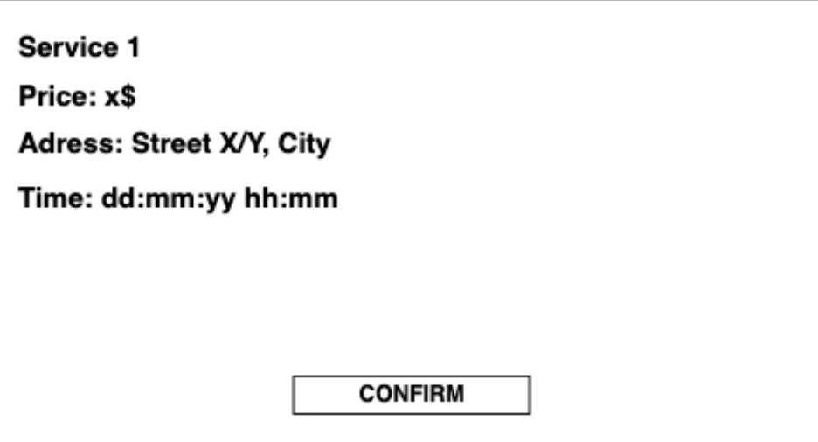
BACK
Use case details
Alternative Flow:
7a. Client Does Not Confirm the Booking (Wants to Change Details)
7a.1 The client decides not to confirm and navigates back to one of the previous booking steps to make changes.

Slide 15
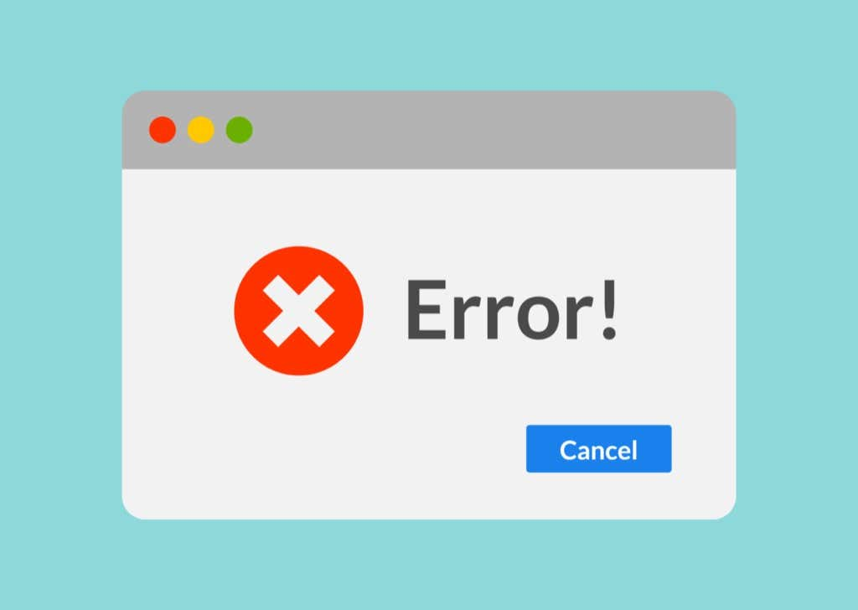

Alternative Flow:
8a. System Error While Creating Booking
8a.1 After the client confirms the booking, the system attempts to create a provisional booking but encounters an error.
8a.2 The system displays an error message: “We’re having trouble creating your booking right now. Please try again in a few minutes.”
8a.3 The client can choose to retry or cancel. On retry, the system attempts to create the booking again.

Slide 16
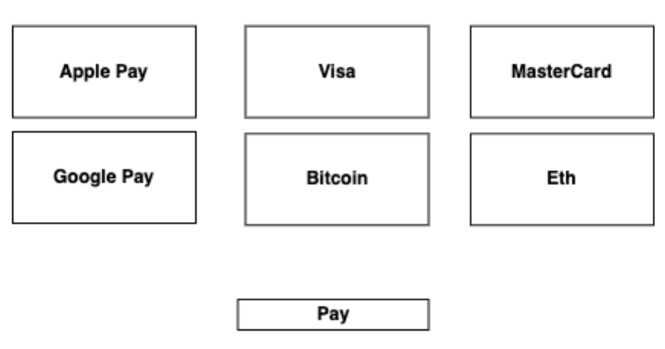
Use case details
Alternative Flow:
9a. Client Leaves During Payment Method Selection
9a.1 The client does not select a payment method and exits the flow.
9a.2 The system cancels the provisional booking.
9a.3 No booking is created.
.

Slide 17
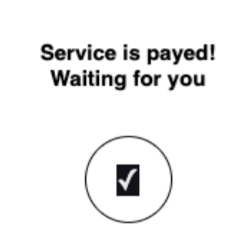
Use case details
Alternative Flow:
10a. Client Does Not Complete Payment
10a.1 The client does not complete the payment.
10a.2 The system cancels the provisional booking.
10a.3 No booking is created.

Slide 18
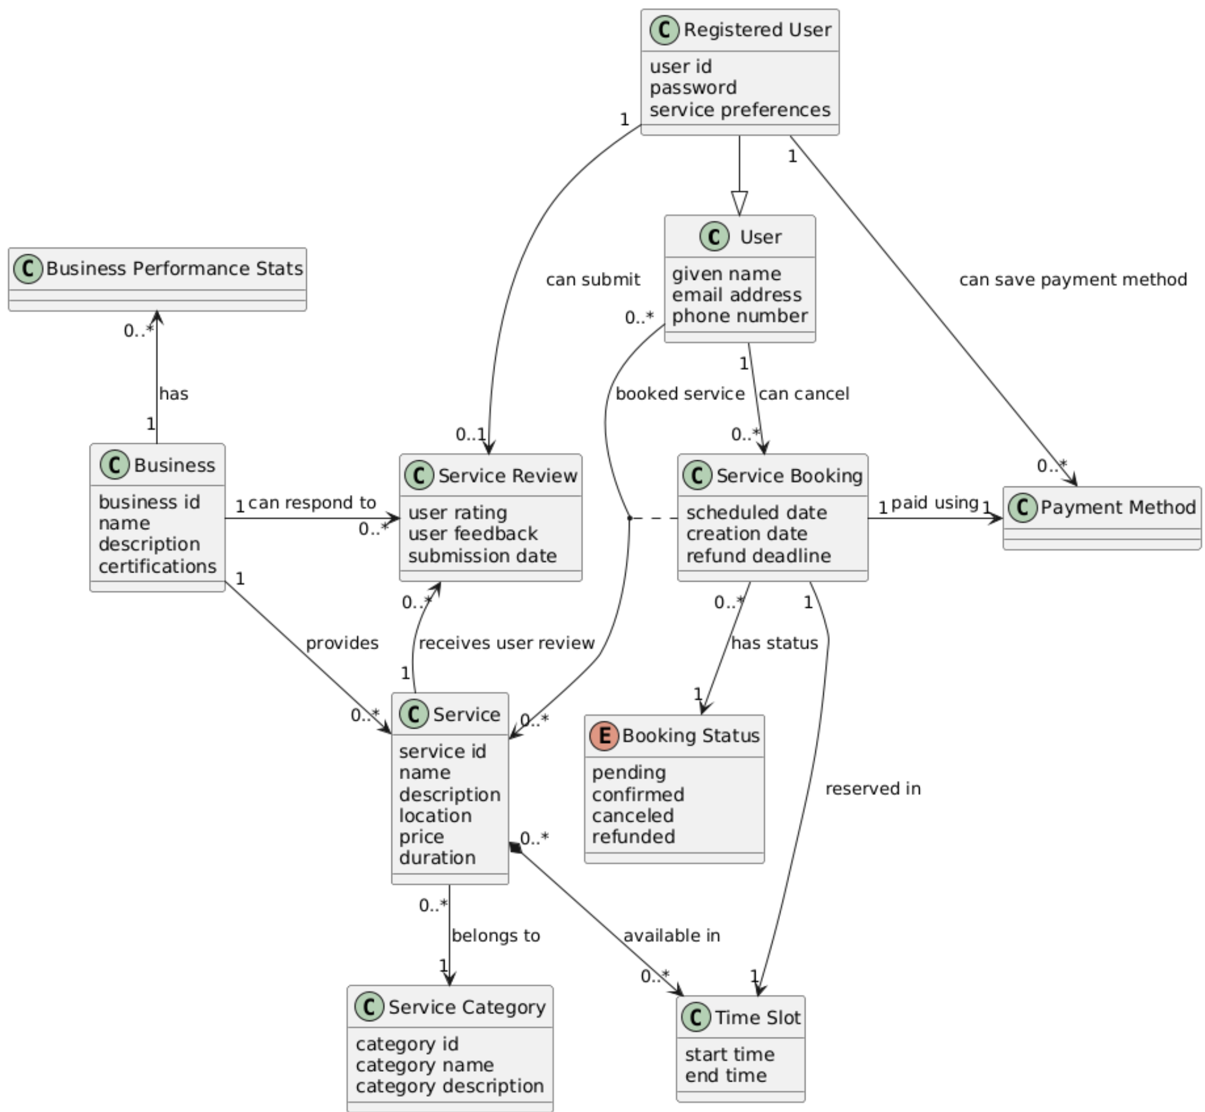
Domain Model

Slide 19
Thank you for your attention!
Created by:
Anastasiia Vivtonenko
Juraj Janíček
Le Duc Hung
Rostislav Lyapkin
Marek Sádovský

